Slide 1
STAT-530 Biochar and their effects on plant growth
Kaniz Fatema
Gordon Harrison
Megha Singh

Slide 2
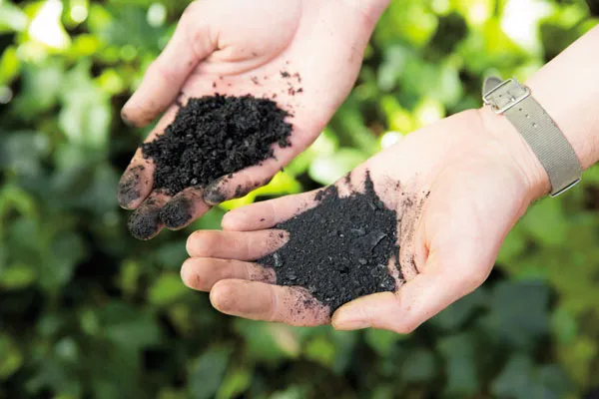
Introduction/Objectives
Biochar can be used to release extra needed nutrients or minerals into soil to promote plant growth
Combustion process of Pyrolysis is used to degrade biochar Precursors into base elements which can then be absorbed by plants
Similar to the idea of fertilizer or manure
https://www.google.com/search?sca_esv=1e618ffcd8ec6d84&rlz=1C1ONGR_en&sxsrf=AHTn8zrTeqGT_Qr7dY7VUtrI_jaeI_l0QA:1745862650112&q=biochar&udm=2&fbs=ABzOT_CWdhQLP1FcmU5B0fn3xuWp5u5rQsC2YJafWTbyNSy6G3Vsi155b_IyTtSTnvQaXi8pqHe_O2hfOzwUB6ozx76JUREYUpcyM78Ln-gOjNjNCk4dms4om5gZlsxkTulLkqrAuQLMLdbTho7KccoLe6Vs6CB3sJf5it-MMCLHZAQkoF550afkai_OQv5vhB-Q1kxCznBzZZNGLi0mrXKqIz6vghQZYQ&sa=X&sqi=2&ved=2ahUKEwjIr9iYpfuMAxWhTDABHbCuOO0QtKgLegQIGBAB&biw=1280&bih=585&dpr=1.5#vhid=PDbpueK6-qrMnM&vssid=mosaic

Slide 3
Introduction/Objectives
Our Primary objective is to see which Biochar precursor will yield the most elements and at which pyrolysis temperature is ideal
Temperature
350C
500C
700C
Biochars
Pine chips (PC)
Poultry litter (PL)
Swine solids (SS)
Switchgrass (SG)
50/50 PC-SG
80/20 PC-SG

Slide 4
Introduction/Objectives
Our second Objective is to see which biochar precursor induces the most growth in 4 plant types
Plant types:
Carrots
Corn
Lettuce
Soybean

Slide 5
Data and Cleaning Process
For this project, 2 sets of related data were used
Sheet One: Biochar Chemical Analysis SH Unit Change 012920
Breakdown of the biochar's and the testing conditions that would be used along with concentrations of elements released(Used for K-means and PCA)
Sheet Two: Carrot SH Revised 012920, Corn SH Revised 012920, Lettuce SH 012920, Soybean SH Revised 012920
These four sheets breakdown the amount of each element that was found in each of the plants corresponding to the test soil and the biochar that was used, included the weight change of the shoot and leaves of plants(Used for ANOVA)

Slide 6
Data and Cleaning Process
The original Biochar Chemical Analysis SH Unit Change 012920 sheet contains the following columns:
Sample, Feedstock, Temperature, Type, Molybdenum (PPM), Copper (PPM), Copper (mg/kg (DO)), Lead(PPM), Zinc(PPM), Zinc(mg/kg(DO)), Argon(PPB), Nickle(PPM), Cobalt(PPM), Manganese(PPM), Manganese(mg/kg(DO)), Iron(%), Iron(g/kg(DO)), Arsenic(PPM), Uranium(PPM), Gold(PPM), Thorium(PPM), Strontium(PPM), Cadmium(PPM), Antimony(PPM), Bismuth(PPM), Vanadium(PPM), Calcium(%), Calcium(g/kg(DO)), Phosphorus(%), Phosphorus(g/kg(DO)), Lanthanum(PPM), Chromium(PPM), Magnesium(%), Magnesium(g/kg(DO)), Barium(PPM), Titanium(PPM), Boron(PPM), Aluminum(%), Aluminum(g/kg(DO)), Sodium(%), Potassium(%), Potassium(g/kg(DO)), Tungsten(PPM), Scandium(PPM), Thallium(Tl), Sulfur(%), Sulfur(g/kg(DO)), Mercury(PPB), Selenium(PPM), Tellurium(PPM), Gallium(PPM).”
The cleaned sheet removed some of the undesirable variables that we were not interested in and contains the following columns:
“Sample, Feedstock, Temperature, Type, Mo, Cu, , Pb, Zn, Zn(DO), Ni, Co, Mn, Mn(DO), Fe, Fe(DO), Th, Sr, Cd, V, Ca, Ca(DO), P(%), P(DO), La, Cr, Mg(%), Mg(DO), Ba, Ti, B, Al(%), Al(DO), Na(%), K(%), K(DO), W”

Slide 7
Data and Cleaning Process
The four plant measurement sheets contain the following columns:
“crop, stakeno, Color, soil, Treatment, feedstock, temperature, trtno, repno, species, tcn, tcngkg, log10tcngkg, arctcn, oc, arcoc, C/N ratio, leafaluminum, leaflog10aluminum, leafboron, leaflog10boron, leafcalcium, leaflog10calcium, leafcopper, leaflog10copper, leafiron, leaflog10iron, leafpotassium, leaflog10potassium, leafmagnesium, leaflog10magnesium, leafmanganese, leaflog10manganese, leafmolybenum, leaflog10molybdenum, leafsodium, leaflog10sodium, leafphosphorus, leaflog10phosphorus, leafsulfur, leaflog10sulphur, leafzinc, leaflog10zinc, revtrdw, revtrdw, revdrdw, log10revdiffrootdw, revisedrootdw, log10totrootdw, ratiotapdiff, arsintapdiff, shdw, logshootdw, shoot/total root ratio, arsinshoottotal, Ngshoot, log10Ngshoot, Alshoot, log10Algshoot, Bshoot, log10Bgshoot, Cashoot, log10Cashoot, Cushoot, log10Cushoot, Feshoot, log10Feshoot, Kshoot, log10Kgshoot, Mgshoot, log10Mgshoot, Mnshoot, log10Mnshoot, Moshoot, log10Moshoot, Nashoot, log10Nashoot, Pshoot, log10Pshoot, Sshoot, log10Sshoot, Znshoot, log10Znshoot, taprootlaboratory, traluminum, trlog10aluminum, trboron, trlog10boron, trcalcium, trlog10calcium, triron, trlog10iron, trlog10iron2, trpotassium, trlog10potassium, trpotassiummgg, trlog10potassiummgg, trmagnesium, trlog10magnesium, trmanagese, trlog10manganese, trmolybdenum, trlog10molybdenum, trsodium, trlog10sodium, trphosphorus, trlog10phosphorus, trsulphur, trlog10sulphur, trzinc, trlog10zinc, gKtaproot, log10gKtaproot, gPtaproot, log10gPtaproot, gCataproot, log10gCataproot, Mggtaproot, log10Mgtaproot, Fegtaproot, log10Fegtaproot, Mngtaproot, log10Mngtaproot, Zngtaproot, log10Zngtaproot”
The cleaned sheet removed some of the undesirable variables that we were not interested in along with filling in some 0 values with close to 0 values and contains the following columns:
“Root Dry weight (g), Shoot Dry weight (g), Total Dry weight (g), crop, stakeno, soil, feedstock, temperature, Total combustible nitrogen in % , total organic in %, % C/% N ratio, Aluminum concentration in µg/g, Calcium concentration in µg/g, Iron concentration in µg/g, Potassium concentration in µg/g, Magnesium concentration in µg/g, Manganese concentration in µg/g, Sodium concentration in µg/g, Phosphorus concentration in µg/g, Zinc concentration in µg/g + 0.1 because of 0's.”

Slide 8
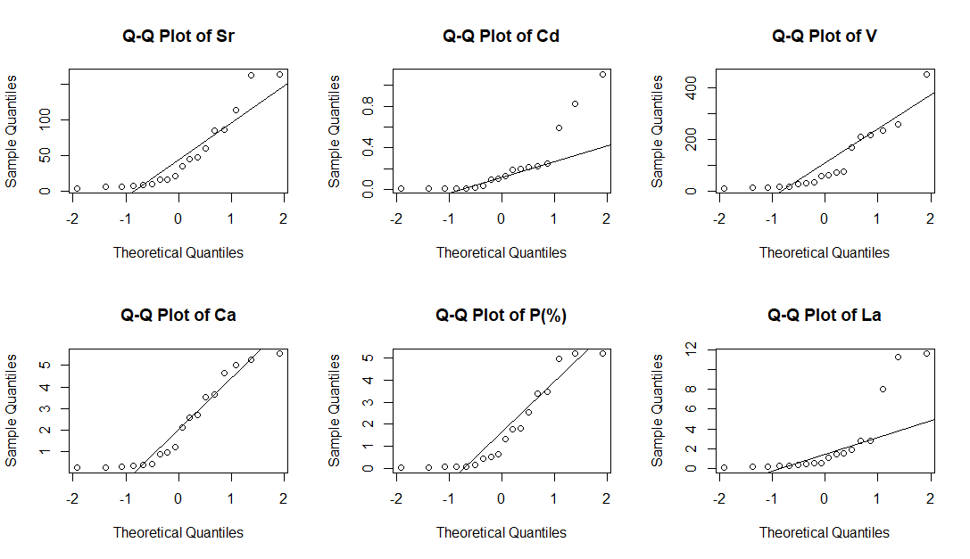
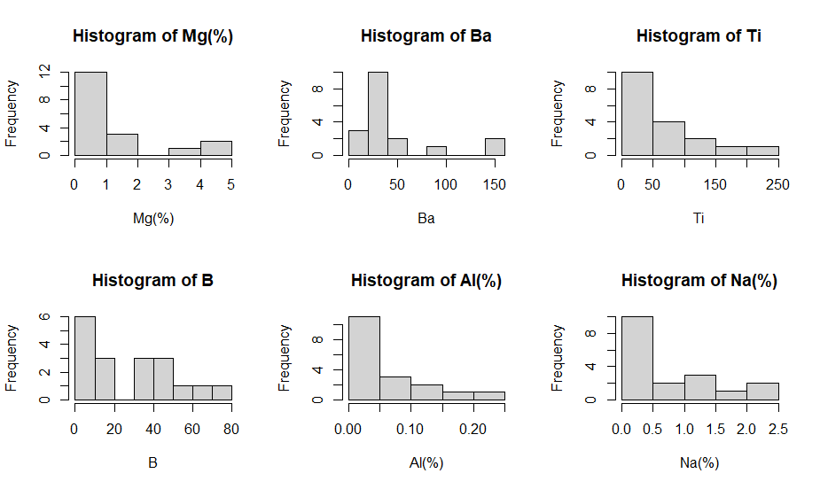
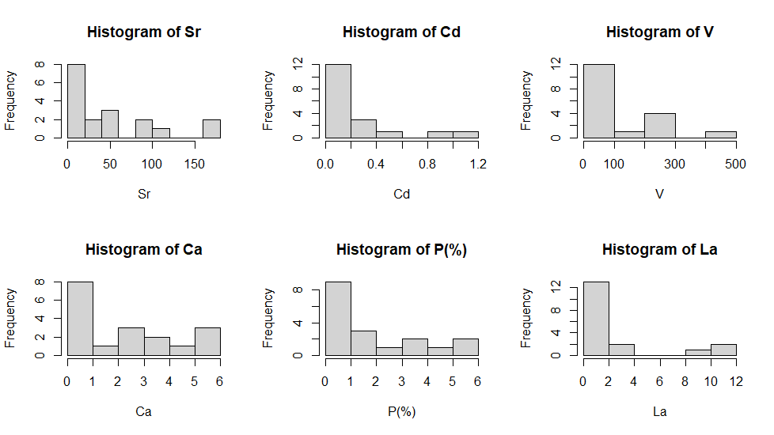
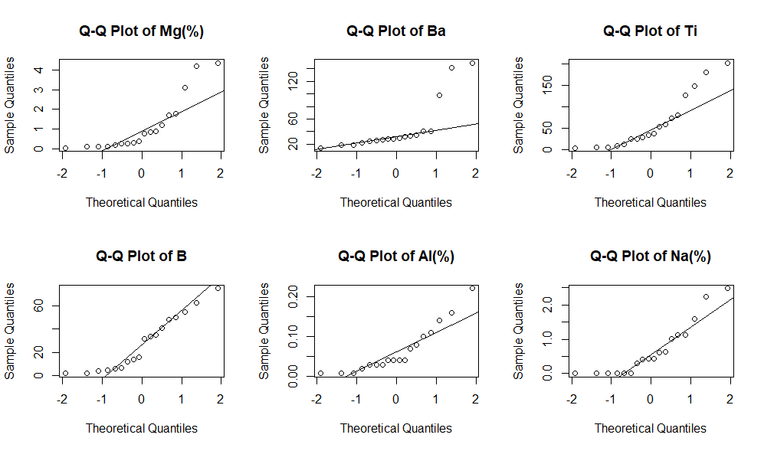

Slide 9
Samples for K Means Clustering and PCA
Sample | Feedstock | Temperature
1 | Pine chips | 350
2 | Pine chips | 500
3 | Pine chips | 700
4 | Poultry Liter | 350
5 | Poultry Liter | 500
6 | Poultry Liter | 700
7 | Swine Solids | 350
8 | Swine Solids | 500
9 | Swine Solids | 700
10 | Switchgrass | 350
11 | Switchgrass | 500
12 | Switchgrass | 700
13 | 50/50 Pine Chip/Switchgrass | 350
14 | 50/50 Pine Chip/Switchgrass | 500
15 | 50/50 Pine Chip/Switchgrass | 700
16 | 80/20 Pine Chip/Switchgrass | 350
17 | 80/20 Pine Chip/Switchgrass | 500
18 | 80/20 Pine Chip/Switchgrass | 700

Slide 10
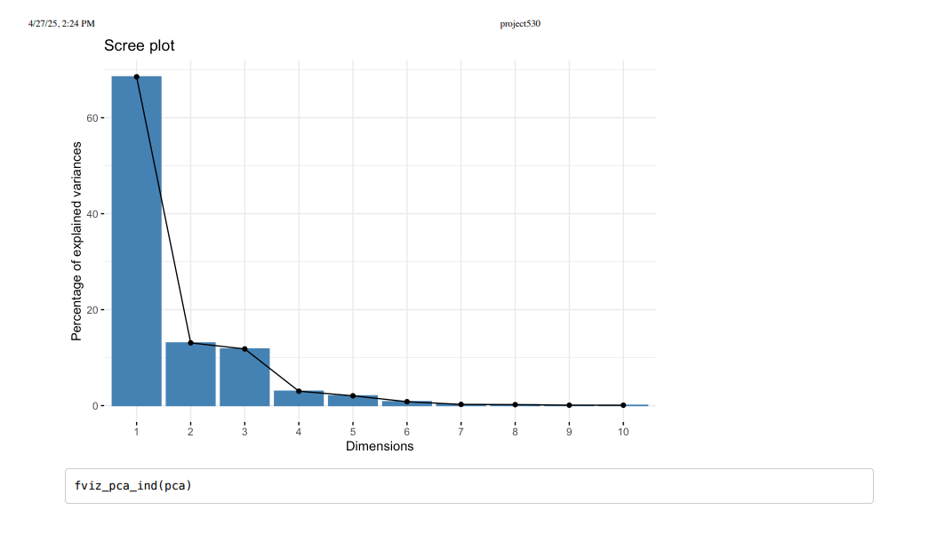
Scree Plot for PCA

Slide 11
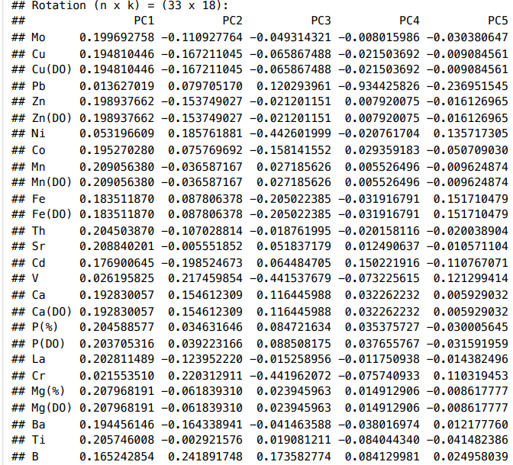
PCA Results

Slide 12
Method One: Principal Choice Analysis(PCA)
PCA was done on the first dataset as well and yielded 2 major principal components. PC1 represents the presence of nutrients produced from the biochar's. PC2 is the presence of soluble elements, reflecting the salinity that will be produced from the bio chars.
A high score in PC1 represents a high concentration of plant needed nutrients, while a low score will indicate a lack of these nutrients
A high score in PC2 represents a high salt content produced from the biochar, while a low score will indicate a lack of salt

Slide 13
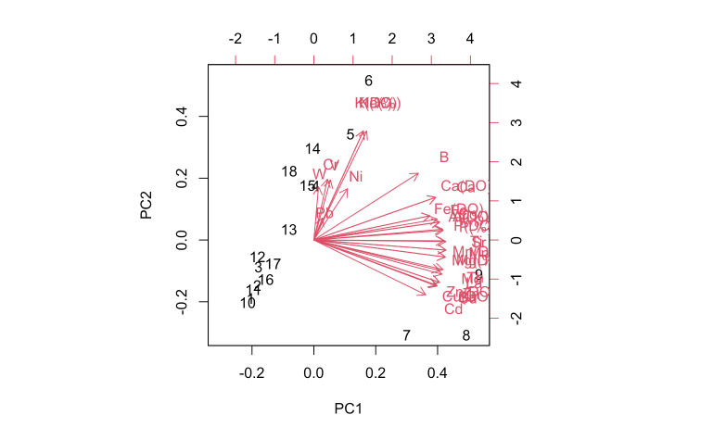
Bi Plot For PCA

Slide 14
Method Two: K Means Clustering
K-means clustering was done on the first set of data to determine what each biochar could bring to the table, 4 main clusters were formed during this process:
Cluster One: Very high nutrient concentration with low salt content
Contains Sample 8,9 ideal conditions for plant growth. Contains samples 4,13,14,15,18 decent nutrients allow for growth however higher salt will counteract water availability in plants, making accelerated growth harder
Cluster Two: High nutrient concentration with low salt content
Contains Sample 7 while not as good as cluster one conditions for growth are still good
Cluster Three: Moderate nutrient concentration with high salt content
Contains samples 4,5,6,14,15,18 decent nutrients allow for growth however higher salt will counteract water availability in plants, making accelerated growth harder
Cluster Four: Low nutrient concentration with low salt content
Contains samples 1,2,3,10,11,12,13,16,17 like Cluster Three however the lack of nutrients will slow the rate of growth even more.

Slide 15
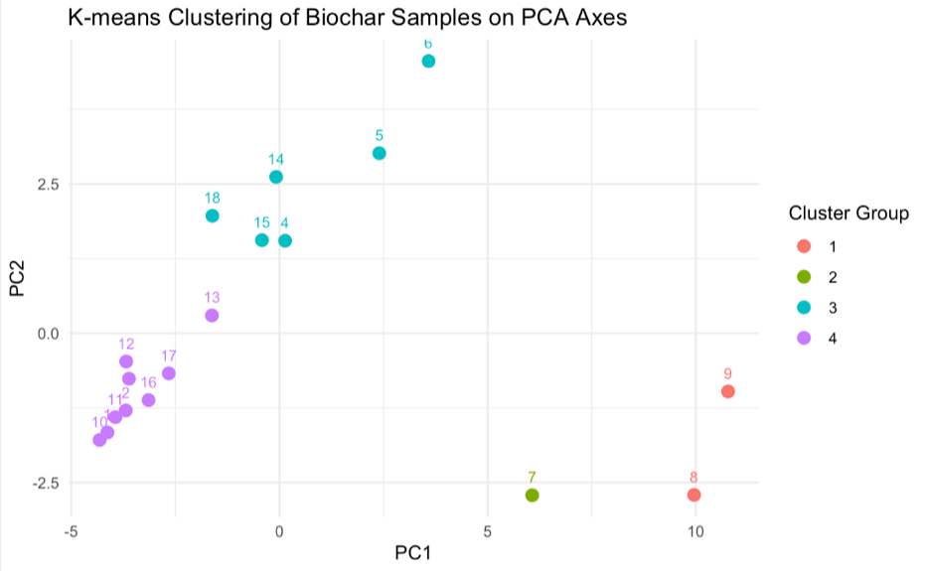
K Means Clustering

Slide 16
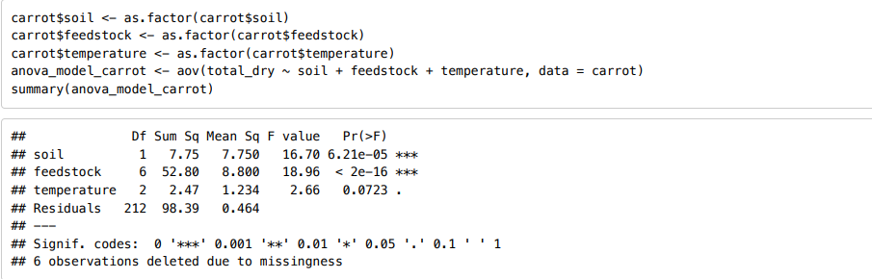
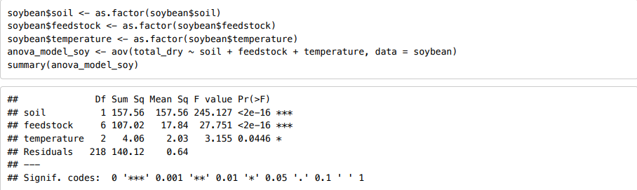
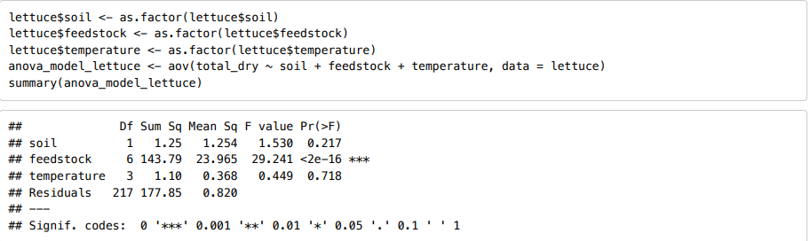
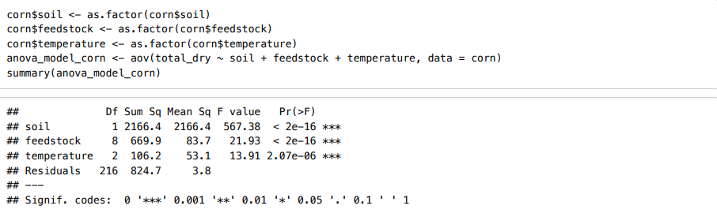
Method Three: ANOVA Analysis
From the ANOVA analysis we found that the feedstock was significant for all plant types

Slide 17
Results
From both K means and PCA, it can be seen that samples 7,8,9 are some of the top contenders for plant growth. As the conditions they produce through pyrolysis leads to more ideal growth conditions: High nutrient concentrations along with lower salt content
ANOVA analysis gave us more of an insight into this as it can be observed that most of the plant growth happened when the plants had Swine Solids used as the biochar precursor.
The results from these approaches lead us to the conclusion that Swine Solids combusted and any temperature will contribute the most to plant growth and the highest presences of nutrients

Slide 18
Challenges
One challenge that was faced was missing data and the lack of large amounts of data, missing data in dataset two would have caused many of the records to not be useable, due to the presence of 0 values, therefore we had to integrate nonzero zero values(very small numbers)
Another challenge was a lack of a response variable in dataset one, which caused the need for dataset two for a regression or ANOVA to be done.

Slide 19
Conclusions
Swine Solids are the top contender for plant growth and nutrient release at any of the listed temperature(350,500,700)
Ramifications of this finding can lead to a larger use of waste material from the meat/pork industry allowing a larger amount of waste to be reused in a beneficial way
Use of Swine Solids as biochar precursor can lead to increased plant growth and the presence of more desirable elements in soil that can be used during other crop growth

Slide 20
Sources
Olszyk, D., Shiroyama, T., Novak, J., Cantrell, K., Sigua, G., Watts, D., & Johnson, M. G. (2020). Biochar affects growth and shoot nitrogen in four crops for two soils. Agrosystems, Geosciences &amp; Environment, 3(1). https://doi.org/10.1002/agg2.20067
Olszyk, D. M., Shiroyama, T., Novak, J. M., Cantrell, K. B., Sigua, G., Watts, D. W., & Johnson, M. G. (2020). Biochar Affects Essential Nutrients of Carrot Taproots and Lettuce Leaves. HortScience horts, 55(2), 261-271. Retrieved Apr 28, 2025, from https://doi.org/10.21273/HORTSCI14421-19
Essential Plant Nutrients. Alabama Cooperative Extension System. (2024, December 9). https://www.aces.edu/blog/topics/farming/essential-plant-elements/

